Slide 1

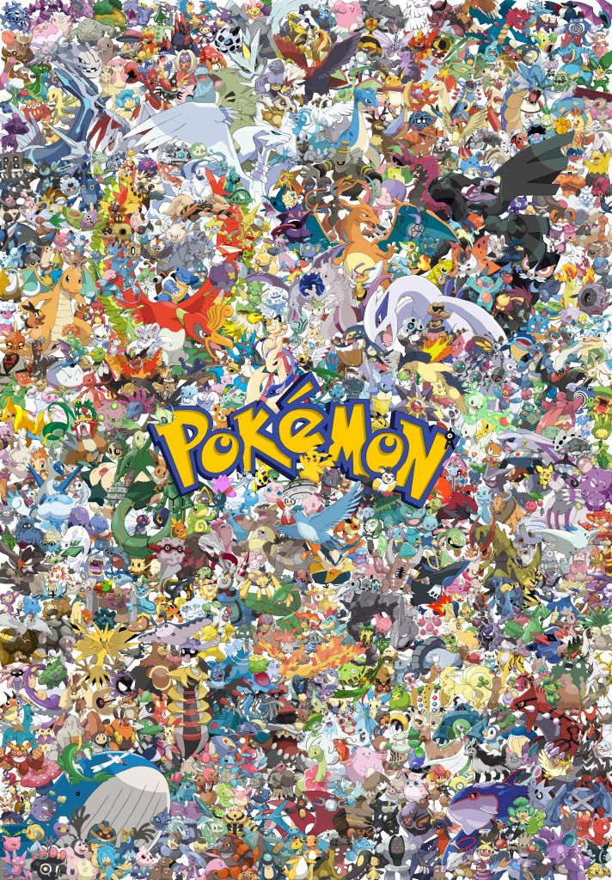
DCGAN-powered Pokémon Generator: A Journey into AI-Generated Pokémon Art
The Pokémon franchise has captivated audiences worldwide, with its diverse array of unique and imaginative creatures. As the demand for new and innovative Pokémon designs continues to grow, the challenge of creating visually appealing and conceptually compelling creatures has become increasingly complex. This presentation explores how Deep Convolutional Generative Adversarial Networks (DCGANs), a powerful class of deep learning models, can be leveraged to generate novel and realistic Pokémon images, opening up new possibilities for artistic exploration and expression within the Pokémon universe.
Presenter: Sanchit Bhardwaj

Slide 2
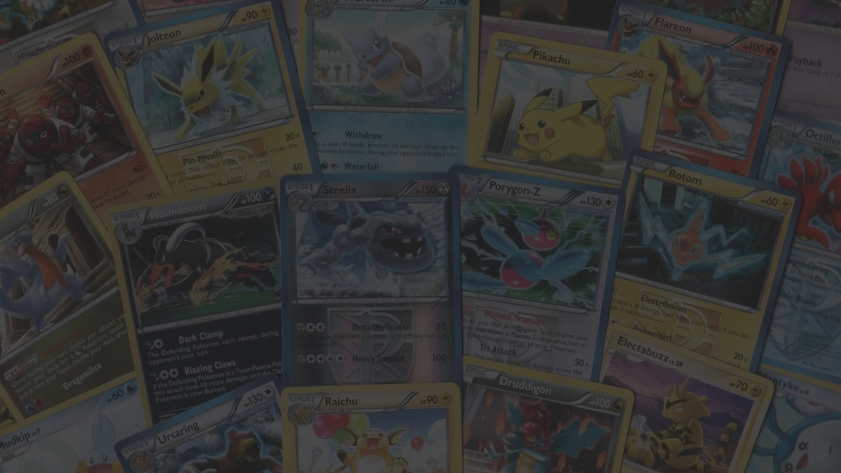
Introduction and Motivation
1
The Pokémon Phenomenon
2
The Challenge of Pokémon Design
3
AI for Creative Exploration
The Pokémon franchise has become a global phenomenon, captivating audiences of all ages with its diverse cast of unique and imaginative creatures. From the original video games to the trading cards, anime series, and extensive merchandising, Pokémon has cemented its place as a beloved and enduring cultural icon.
Creating new and visually appealing Pokémon designs is a challenging task that requires a deep understanding of the franchise's aesthetics, lore, and character archetypes. Designers must balance creativity, originality, and recognizability to develop Pokémon that resonate with fans and fit seamlessly into the Pokémon universe.
Advances in deep learning, particularly in the field of Generative Adversarial Networks (GANs), present an opportunity to explore the creative potential of AI-generated art. By leveraging the power of DCGANs, the goal of this project is to develop a model capable of generating novel and realistic Pokémon images, expanding the artistic possibilities within the Pokémon franchise.

Slide 3
Deep Convolutional Generative Adversarial Networks (DCGANs)
GANs in a Nutshell
DCGAN Architecture
Training Process
Generative Adversarial Networks (GANs) are a class of deep learning models that consist of two neural networks, known as the Generator and the Discriminator, which are trained in an adversarial manner. The Generator learns to generate realistic-looking data, while the Discriminator learns to distinguish between real and generated data, effectively pushing the Generator to produce more convincing outputs.
Deep Convolutional Generative Adversarial Networks (DCGANs) are a specific implementation of GANs that leverage convolutional and transposed convolutional layers in the Generator and Discriminator networks. This architecture allows for the generation of high-quality, realistic images by capturing the spatial and hierarchical features present in the training data.
The training of a DCGAN model involves an iterative process where the Generator and Discriminator networks compete against each other. The Generator learns to produce increasingly realistic-looking Pokémon images, while the Discriminator becomes better at distinguishing between real and generated images. This adversarial training procedure enables the DCGAN to generate novel and convincing Pokémon designs.

Slide 4
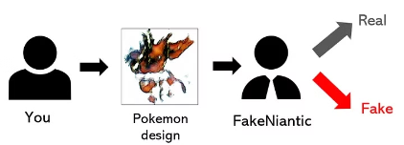
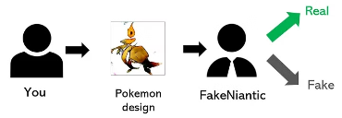
Understanding DCGANs:The Graphic Designer Analogy
Imagine: You're a graphic designer hired to create
new Pokémon for a company (FakeNiantic).
At first: Your designs are rough, lacking
the essence of real Pokémon (show Figure 1).
FakeNiantic tells you to improve.
Over time: You study existing Pokémon, gaining
experience and creating more convincing designs
(show Figure 2 with improved design).
But: FakeNiantic also gets better at spotting fakes,
even as your designs improve. It's a constant competition!
Figure 1
Figure 2

Slide 5
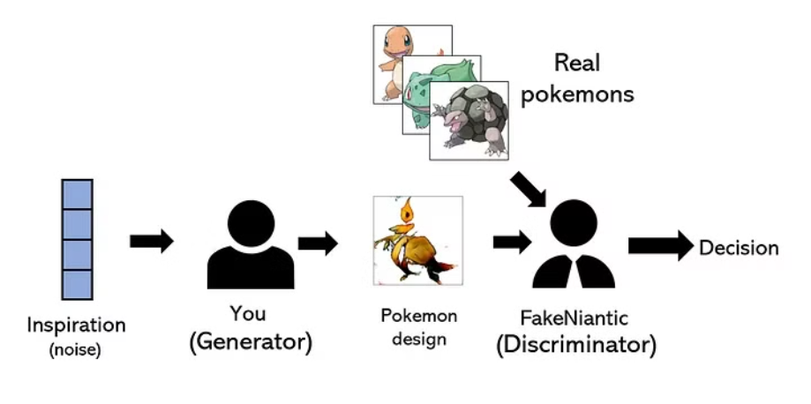
DCGAN Components: The Generator and Discriminator
This competition is the core idea behind GANs (Generative Adversarial Networks).
Generator (You, the Designer):
Takes random input ("inspiration" or "noise").
Creates new Pokémon images from this input.
Goal: Generate images so real they fool the Discriminator.
Discriminator (FakeNiantic, the Client):
Takes an image as input.
Decides if the image is real (from the Pokémon dataset) or fake (created by the Generator).
Goal: Become increasingly skilled at distinguishing real from fake Pokémon.
Show Figure 3: GAN Architecture - Explain how the Generator and Discriminator interact and learn from each other
Figure 3

Slide 6

DCGAN Model Implementation
PyTorch Framework
Network Architectures
The DCGAN model for generating Pokémon images was implemented using the PyTorch deep learning framework. PyTorch provides a powerful and flexible environment for building, training, and deploying deep learning models, making it a popular choice for researchers and developers working on a wide range of AI-powered applications.
The DCGAN model consists of a Generator network that learns to create realistic-looking Pokémon images, and a Discriminator network that distinguishes between real and generated images. The Generator utilizes a series of transposed convolutional layers to upscale a low-dimensional input noise vector into a high-resolution Pokémon image, while the Discriminator employs convolutional layers to extract meaningful features from the input images.
Loss Function and Optimizer
The training of the DCGAN model is guided by the Binary Cross-Entropy loss function, which measures the similarity between the Discriminator's predictions and the true labels (real or generated). The Adam optimizer is used to efficiently update the model parameters during the iterative training process, allowing the Generator and Discriminator to converge to their optimal states.

Slide 7
Training and Evaluation
Training Process
1
During the training phase, the DCGAN model alternates between updating the Generator and Discriminator networks. The Discriminator is trained to accurately distinguish real Pokémon images from the generated ones, while the Generator is trained to produce increasingly realistic Pokémon images that can fool the Discriminator. This adversarial training procedure continues until the model converges, with the Generator producing high-quality, novel Pokémon designs.
2
Visualization of Training Progress
The training progress of the DCGAN model can be visualized by plotting the evolution of the Generator and Discriminator losses over the course of the training epochs. These loss curves provide insights into the model's learning dynamics, highlighting the gradual improvement in the Generator's ability to generate realistic Pokémon images and the Discriminator's increasing difficulty in distinguishing real from generated data.

Slide 8
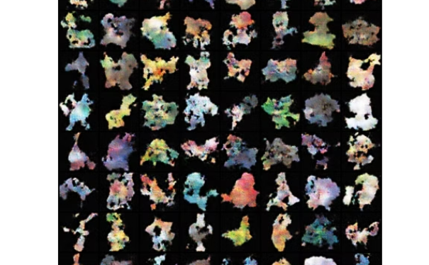
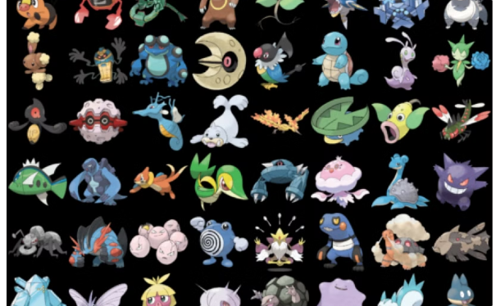
Generated Pokémon Showcase
Diverse Designs
Evolving Creativity
The DCGAN model has successfully generated a diverse collection of novel and visually compelling Pokémon designs. These AI-generated Pokémon exhibit a wide range of shapes, colors, and features, showcasing the model's ability to capture the creative diversity and imagination that are hallmarks of the Pokémon franchise.
The training process of the DCGAN model can be visualized through an animation that demonstrates the progressive improvement in the quality and realism of the generated Pokémon images. This animation highlights the model's ability to learn and refine its Pokémon generation capabilities over time, paving the way for even more innovative and captivating designs.

Slide 9
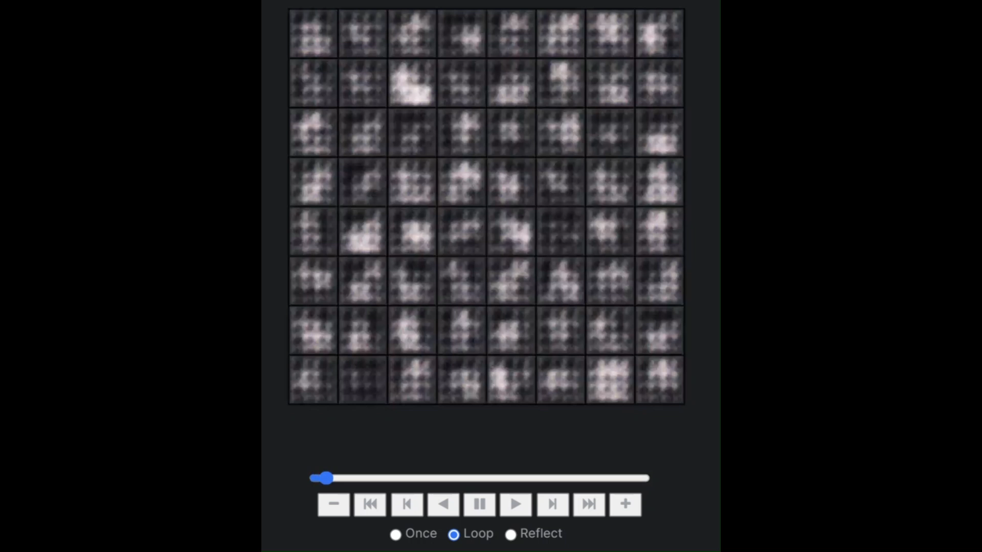


Slide 10



Scope of Improvement and Future Directions
Model Architecture
Data Augmentation
Latent Space Exploration
Exploring alternative DCGAN architectures and incorporating techniques such as skip connections, attention mechanisms, or residual learning could further enhance the model's ability to generate more diverse and visually appealing Pokémon designs.
Implementing advanced data augmentation techniques, such as geometric transformations, color jittering, or style transfer, could help the DCGAN model learn more robust and generalized Pokémon features, leading to an even broader spectrum of generated creatures.
Investigating the latent space of the DCGAN model and developing methods to control and manipulate the generated Pokémon designs could open up new avenues for creative expression and allow for more targeted and customized Pokémon generation.

Slide 11



Conclusion
Project Success
AI's Creative Potential
Future Impact
The development of a DCGAN-powered Pokémon generator has successfully demonstrated the potential of AI-driven creative exploration within the Pokémon universe. The model's ability to generate novel and visually compelling Pokémon designs showcases the power of deep learning as a tool for artistic expression and innovation.
This project highlights the growing role of AI in expanding the boundaries of creative endeavors. By leveraging the generative capabilities of DCGANs, the Pokémon generator opens up new possibilities for artists, designers, and fans to explore the rich and imaginative world of Pokémon through AI-powered artistic exploration.
The success of this DCGAN-powered Pokémon generator project holds the potential to inspire further advancements in the field of AI-generated art and character design. As the Pokémon franchise continues to evolve, the integration of such AI-driven tools could lead to new and exciting creative directions, enriching the experiences and imaginations of Pokémon fans worldwide.

Slide 12
Thank You
For Your Time
And
Attention!

